Slide 1
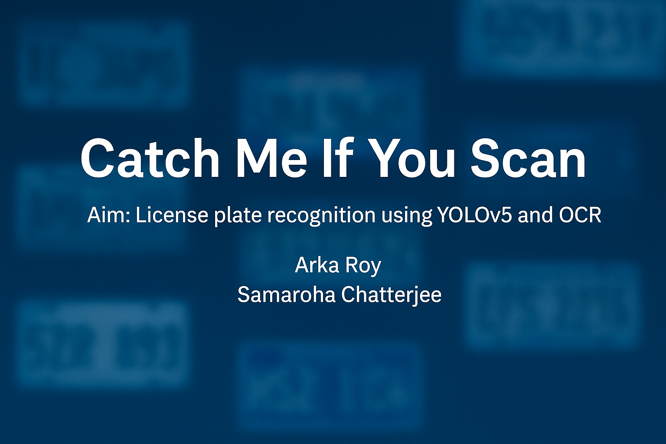

Slide 2

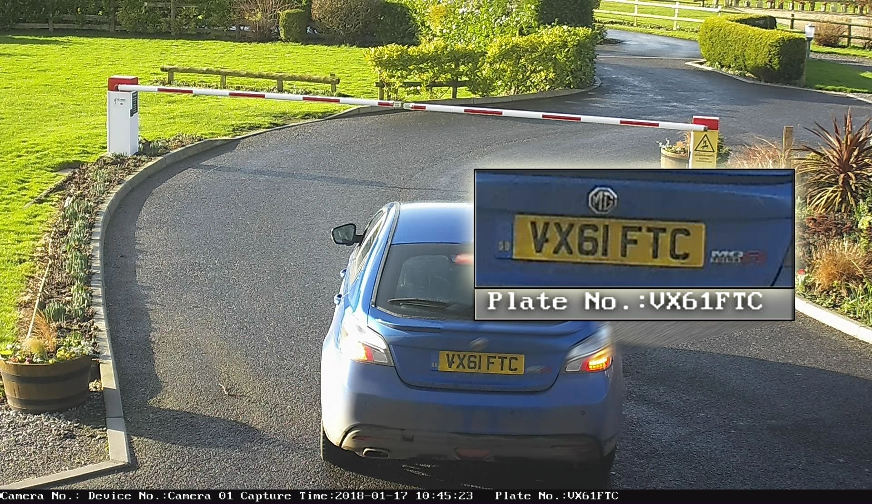
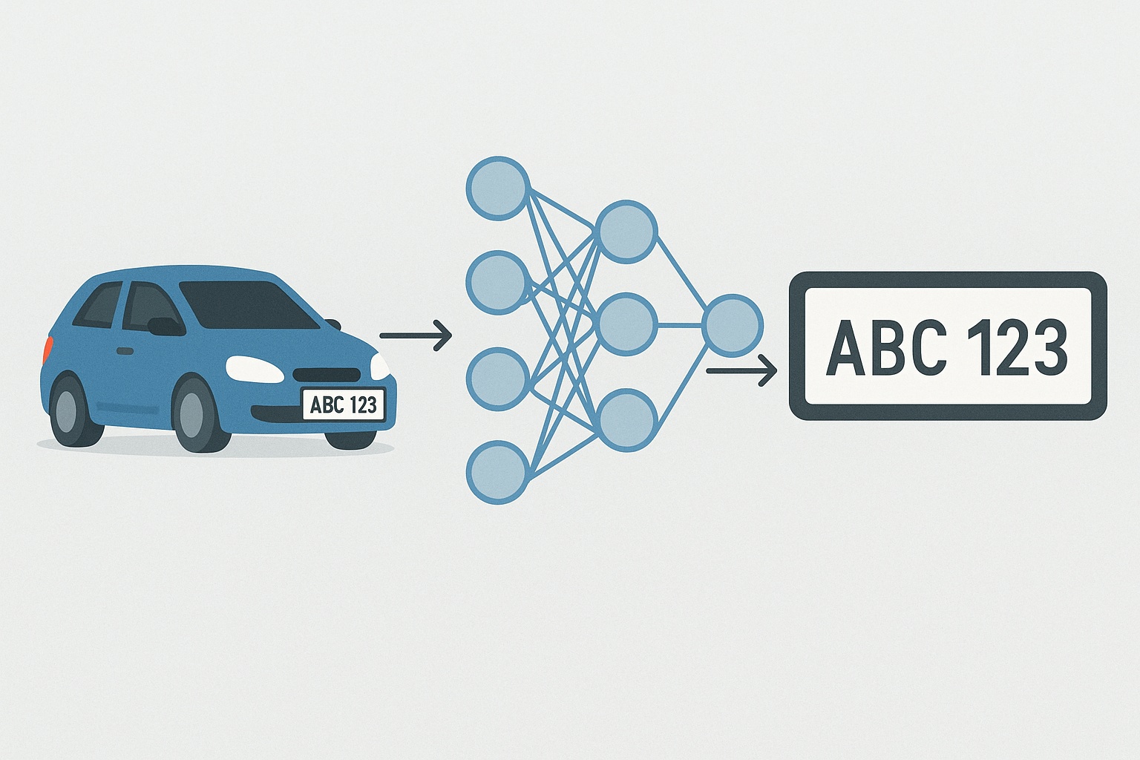
Problem Formulation
The given problem is to design a model which would detect a vehicle number plate automatically and in addition to that extract the text and number from the detected number plate image using Optical character recognition(OCR). So it's a combination of both object detection(detecting number plate) and OCR(extract text from images).
Number plate detection can be done by using deep learning-based state-of-the-art convolutional neural network such as YOLO, SSD with resnet, Faster-RCNN, and many more. Each model has its own trade-off between speed and mAP. In this project, YOLOv5 was used which is based on the PyTorch library.

Slide 3
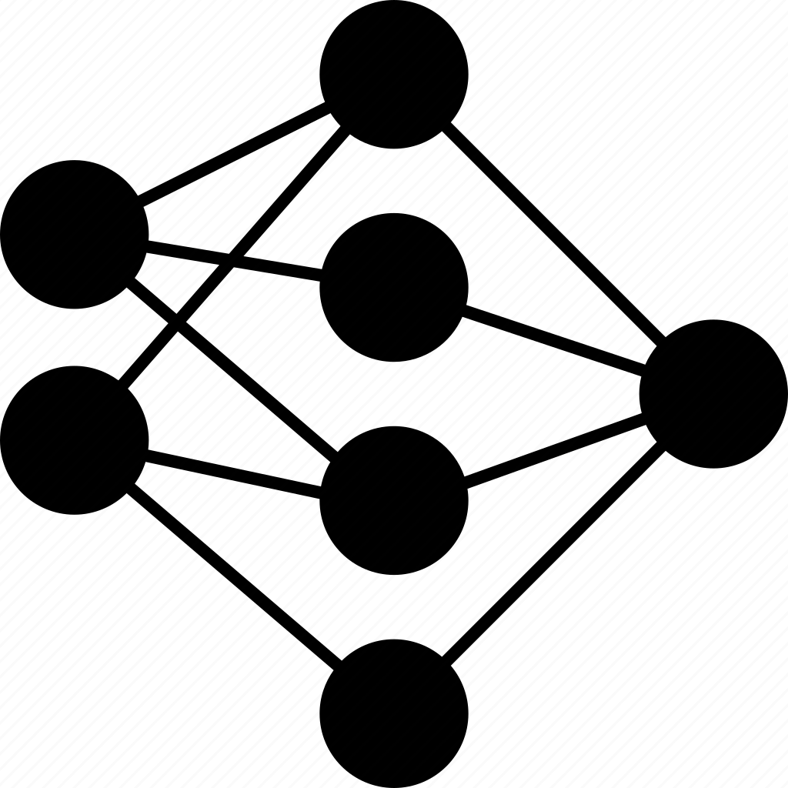
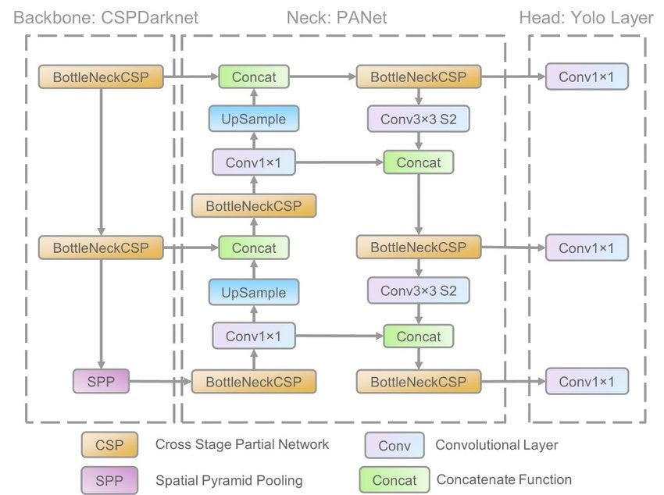
Neural Network Architecture

Slide 4
Neural Network Architecture
Its architecture mainly consisted of three parts, namely-
Backbone: Model Backbone acts as a feature extractor from an input image. Feature extractor is nothing but using convolutional layers such as kernel, stride, batch normalization applies on input images to extract important features such as edges, shapes, and so on. CSP(Cross Stage Partial Networks) are used as a backbone in YOLO v5 to extract useful characteristics from an input image.
Neck: In the Neck layer, the network was designed to perform Multi-scale prediction in addition to the Feature pyramid network. Multi-scale prediction helps to detect objects of different sizes by sending images into three different grid values. So small grid images detect large objects and large grid images detect small objects.
Head: The model Head is mostly responsible for the final detection step. It uses anchor boxes to construct final output vectors with class probabilities, objectness scores, and bounding boxes.
This full network was trained to perform regression task which is nothing but coordinates of a bounding box and the probability of a class

Slide 5

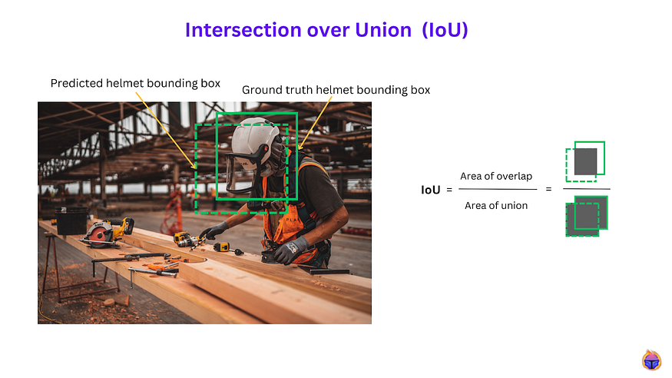
Performance metrics
The green-colored rectangle box is a ground truth and the red-colored rectangle box is predicted by the model. IoU measures the area of overlap between two rectangles. he above formula is similar to the Jaccard similarity. The ideal case of IoU is 1 because in this case, the overlap of ground truth bounding box and predicted bounding box is a perfect match. The worst case is 0. Normally, in the object detection model, the common threshold value is 0.5 to consider the prediction is correct. Otherwise, the prediction is incorrect. So this is simply a binary classification model if our dataset has only one class label.
In this project, our dataset has only one class label (i.e) detecting number plate. So consider this as a simple binary classification model. If IoU is greater than or equal to 0.5, then the prediction is correct otherwise it's incorrect.

Slide 6
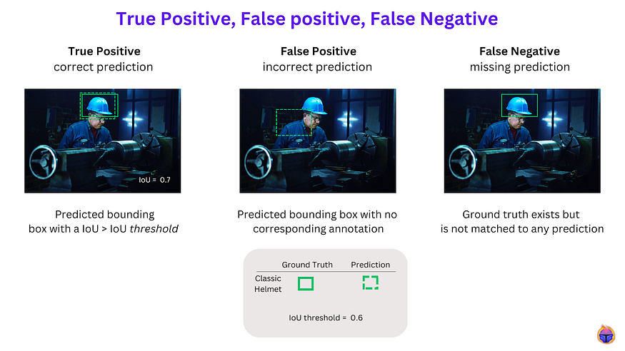
Performance metrics
Mean Average Precision

Slide 7
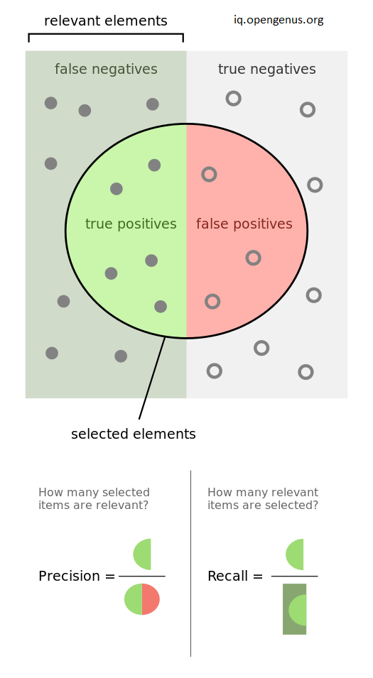
Performance metrics
Precision-Recall
Confidence threshold
Confidence threshold
In object detection, a confidence threshold determines the minimum confidence score required for a prediction to be considered “valid”.
Predictions with a confidence score below the confidence threshold are ignored and excluded from subsequent calculations. If there is a ground truth bounding box corresponding to an ignored prediction, it counts as a false negative -a missed detection.
Setting a higher confidence threshold results in fewer but more reliable predictions, while a lower value threshold results in more prediction but with a higher likelihood of false positives:
• Lower confidence threshold => higher Recall, at the risk of more false positives
• Higher confidence threshold => higher Precision, at the risk of more false negatives

Slide 8
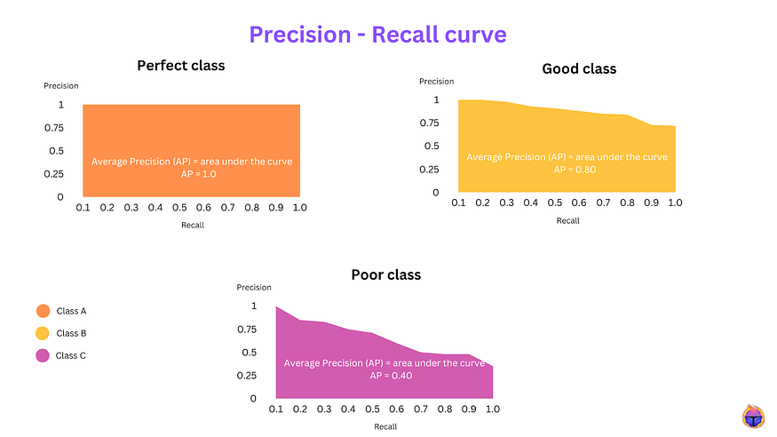
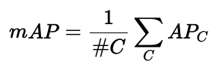
Performance metrics
Mean Average Precision
The value of Mean average precision should be between 0 and 1

Slide 9

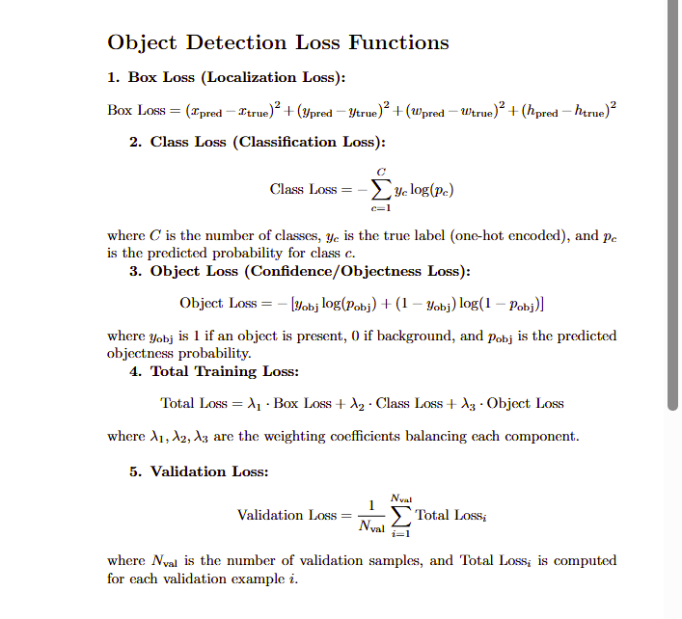
Loss Functions

Slide 10

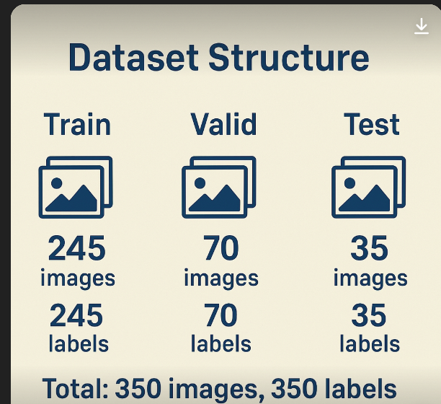
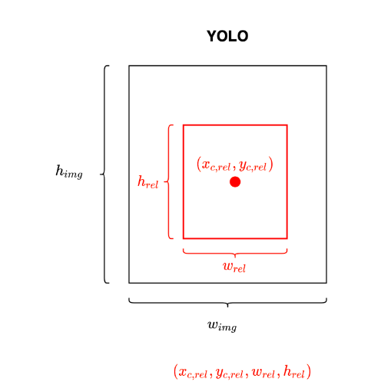
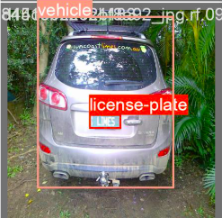

Dataset
We have used a dataset annotated for training in yolov5 by Roboflow, a website for custom dataset building for computer vision related task.

Slide 11

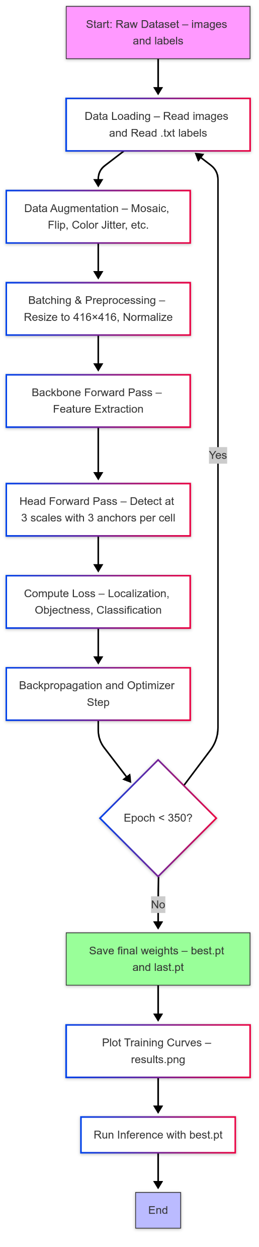
Model-Training

Slide 12

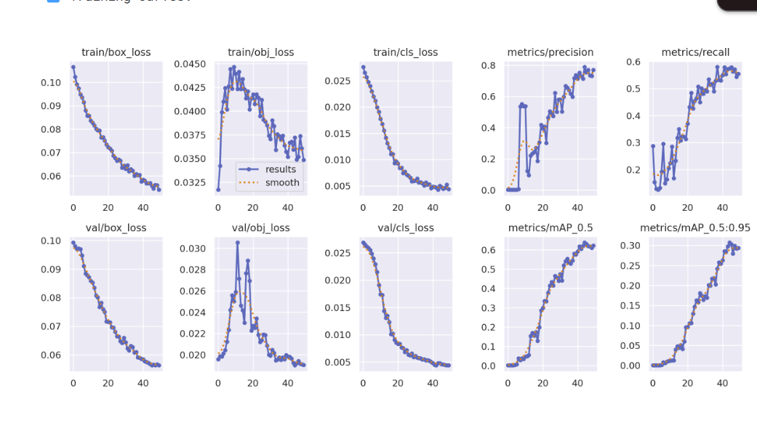
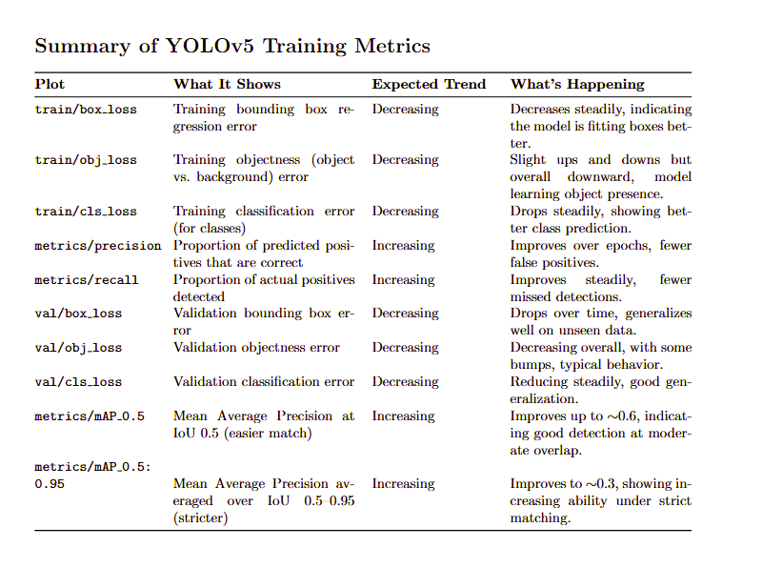
Results

Slide 13
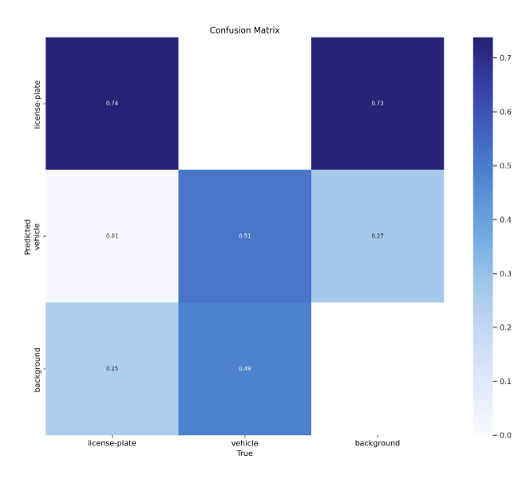
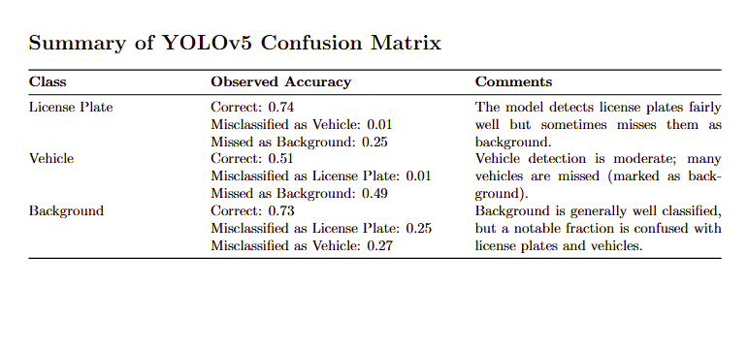
Results

Slide 14
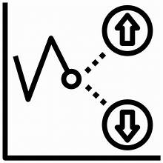
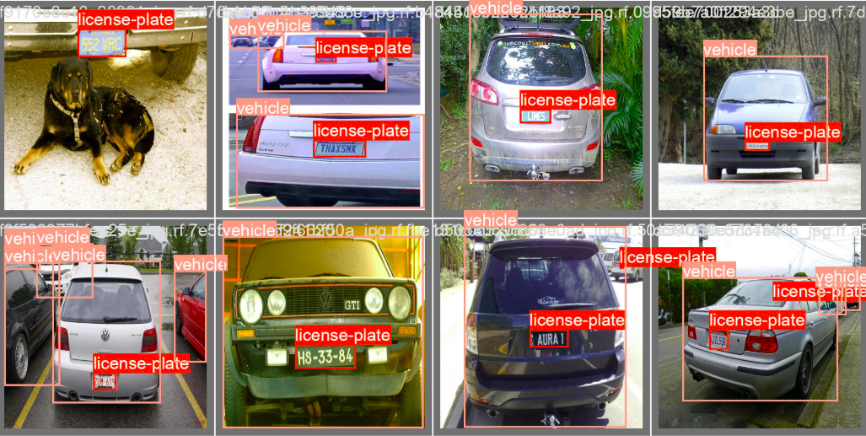
Sample Predictions
Ground Truth

Slide 15
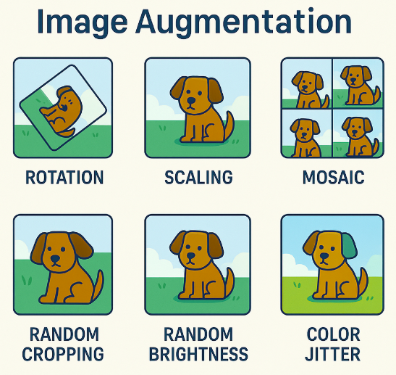
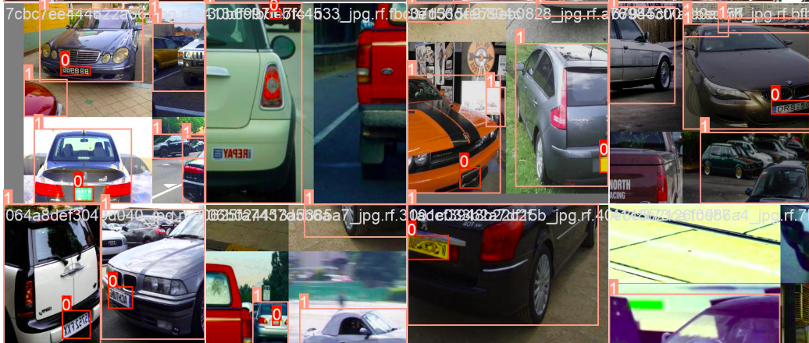
Sample Predictions
Augmented Data
Types of Augmentation

Slide 16
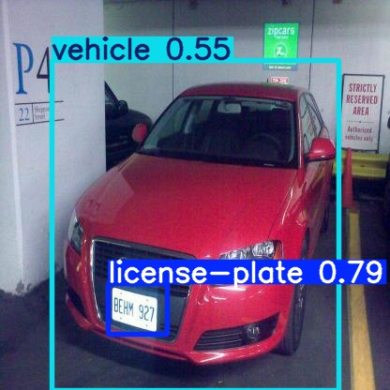
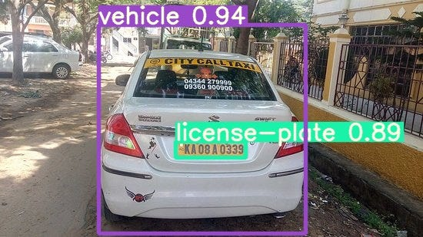
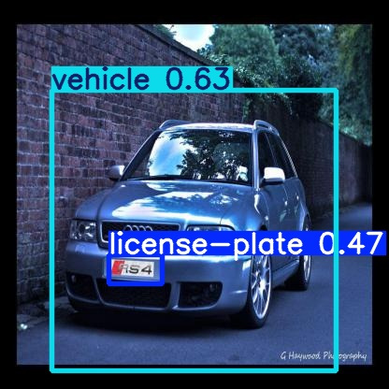
Sample Predictions
Here we have two classes: class 0 for number plate and class 1 for the car. So for each prediction on test images, the model provide the following results:
The confidence score for car, ex: the model is 55% confident that the box contains a vehicle
The confidence score for license plate,ex the model is 79% confident that the box contains a vehicle
The bounding box co-ordinates for car and number plate.
It also predict an object score: How likely a box contains any object or just background

Slide 17
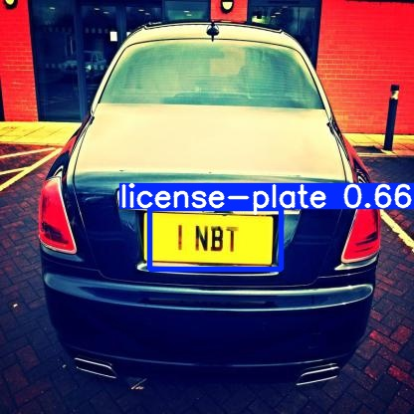
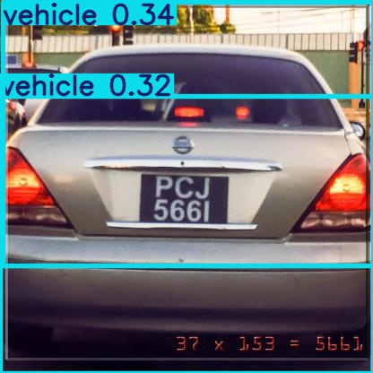
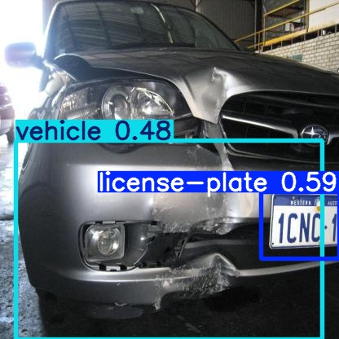
Sample Predictions
Some erroneous predictions

Slide 18
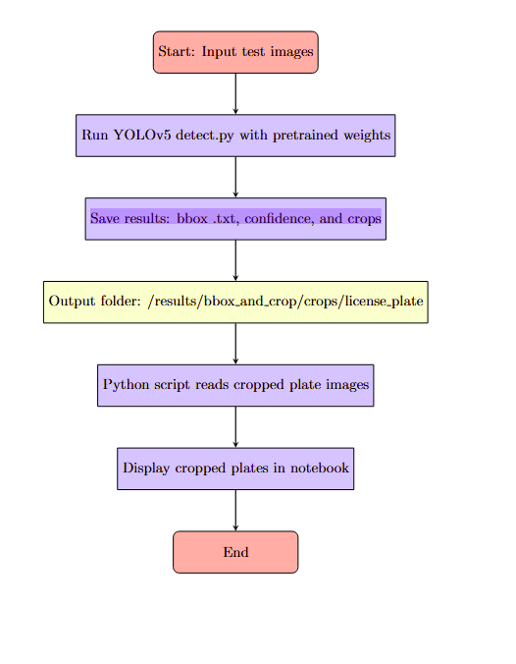

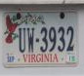
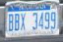
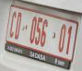
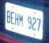
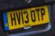
Sample Predictions
bbox .txt → For each detected object (like a license plate), it writes a text file containing:
class ID (e.g., license plate = 0, vehicle = 1)
normalized bounding box coordinates (center x, center y, width, height) relative to the image
confidence → Along with the bbox, it saves the confidence score (probability) for each detection
crops → The script automatically crops the license plates and saves these images in a folder

Slide 19

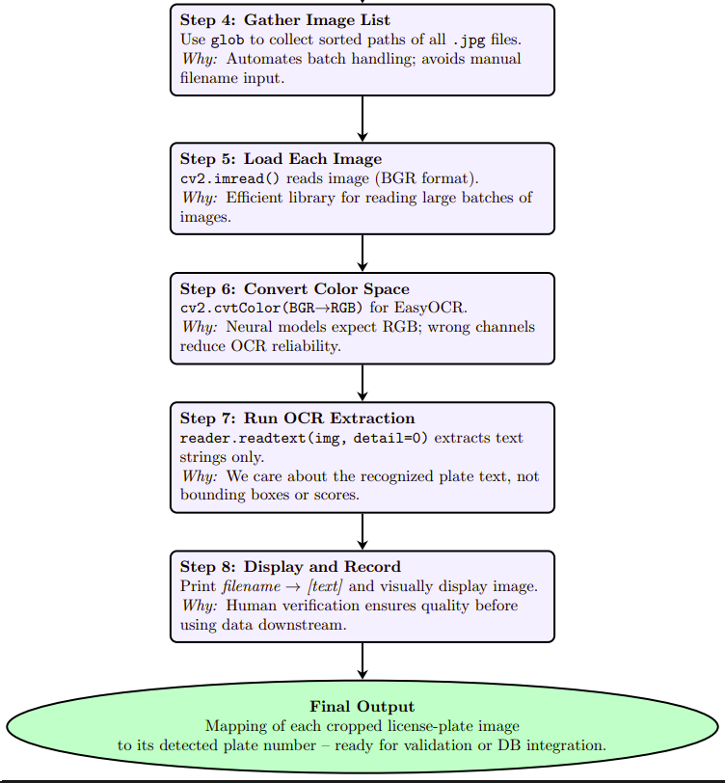
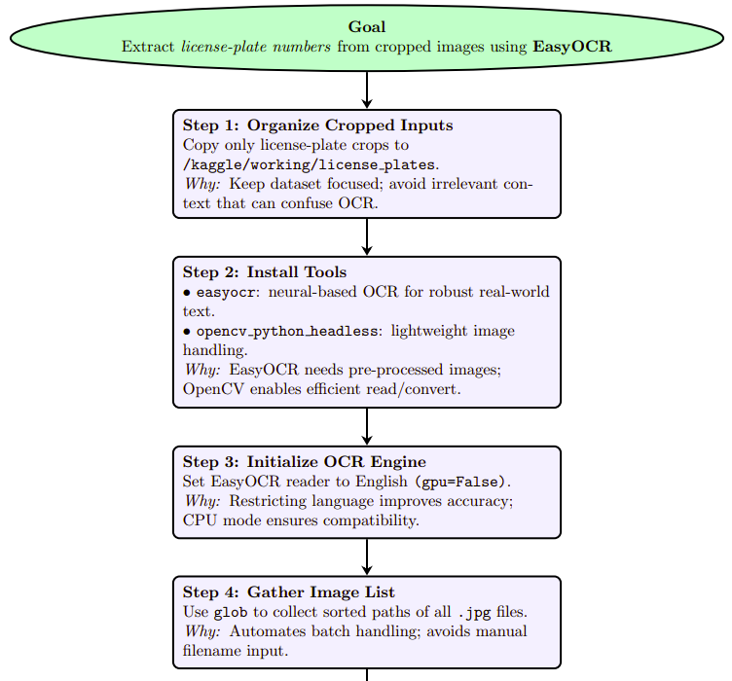
OCR Detection- Algorithm

Slide 20
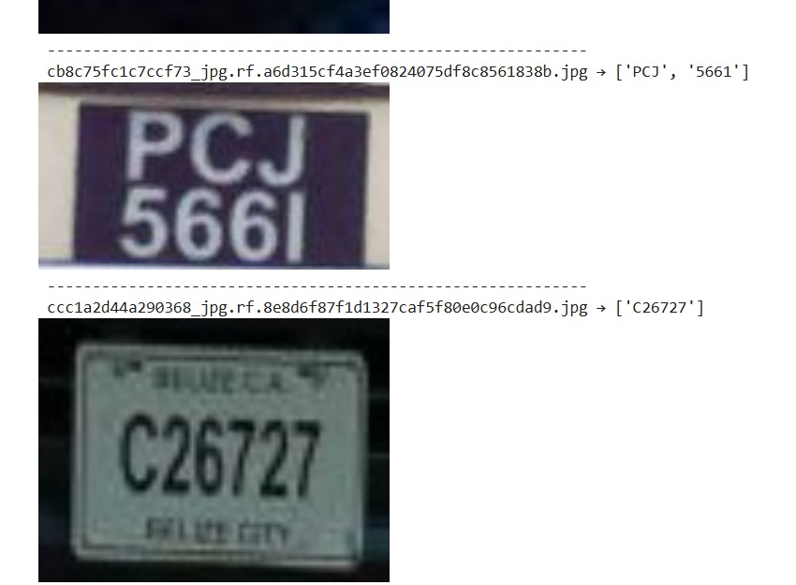
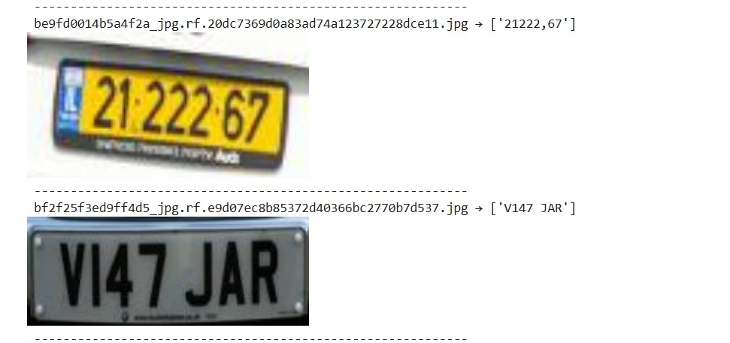
OCR Detection- Results

Slide 21
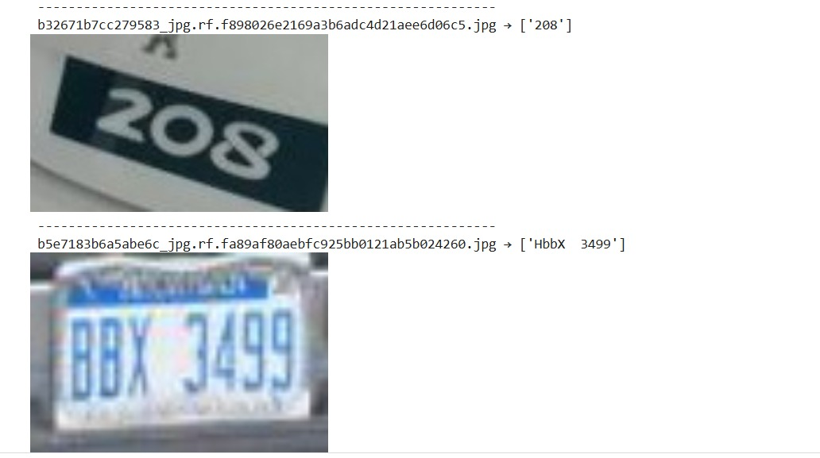
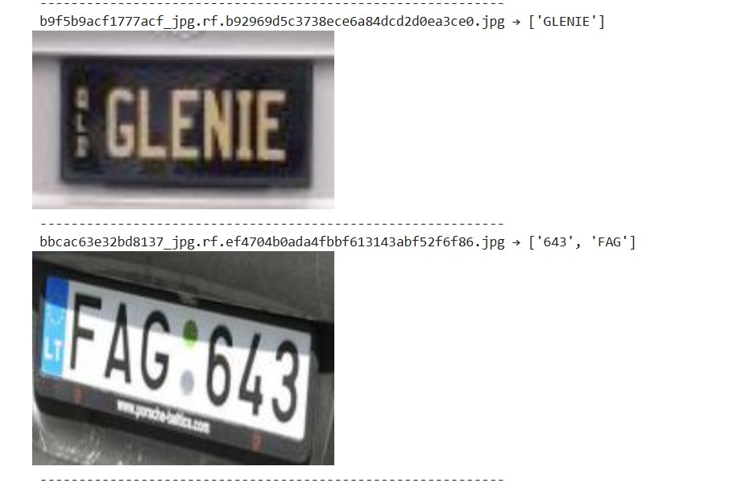
OCR Detection- Results

Slide 22


References
https://medium.com/@ashok.1055/automatic-number-plate-detection-using-yolov5-and-extraction-of-text-using-ocr-2868668aa479
https://docs.ultralytics.com/models/yolov5/
https://docs.ultralytics.com/yolov5/tutorials/architecture_description/
THANK YOU

